Slide 1
Week 11 class 1: monitoring and evaluation
INST408C: Cognitive Security | Fall 2021 | SJ Terp

Slide 2
INST408C Week
Monday
M&E: theory
Wednesday
M&E: practice
Readings
* https://www.futurelearn.com/info/courses/combating-disinformation-and-fake-news/0/steps/157095
Assignments
Notes:
Links:

Slide 3
What are we measuring?

Slide 4
The medium is the message
McLuhan’s “The medium is the message”: the forms and methods used to communicate information have a significant impact on the messages they deliver (including meanings and perceptions”
“Never mind the content; what’s important is the medium… the media are extensions of our senses; as they change, they transform our environment and affect everything we do -- they “massage” or reshape us” - McLuhan

Slide 5
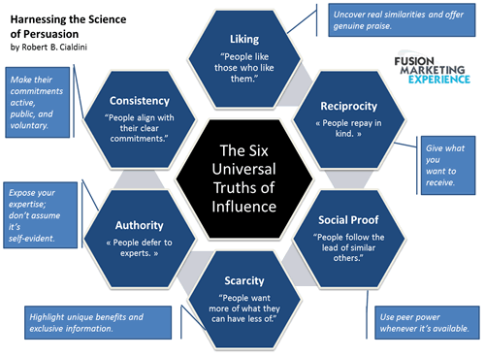
Using those biases

Slide 6

Network contagion
Notes:
Links
Image: https://commons.wikimedia.org/wiki/File:Social_Network_Analysis_Visualization.png
Paper to check out: https://www.pnas.org/content/106/51/21544

Slide 7
Monitoring and Evaluation: History
Notes:
https://blog.hootsuite.com/social-media-metrics/

Slide 8
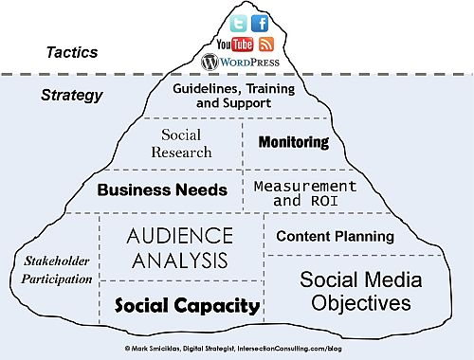
Marketing has a lot to teach us
Notes:
Links
Image: https://www.flickr.com/photos/intersectionconsulting/5332653015

Slide 9
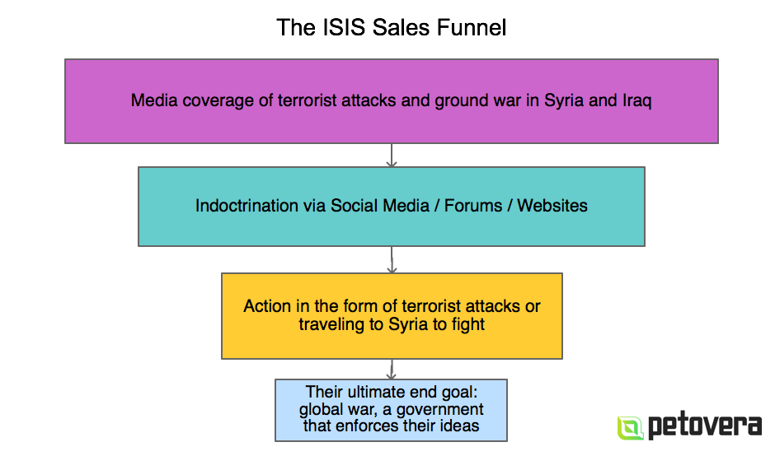
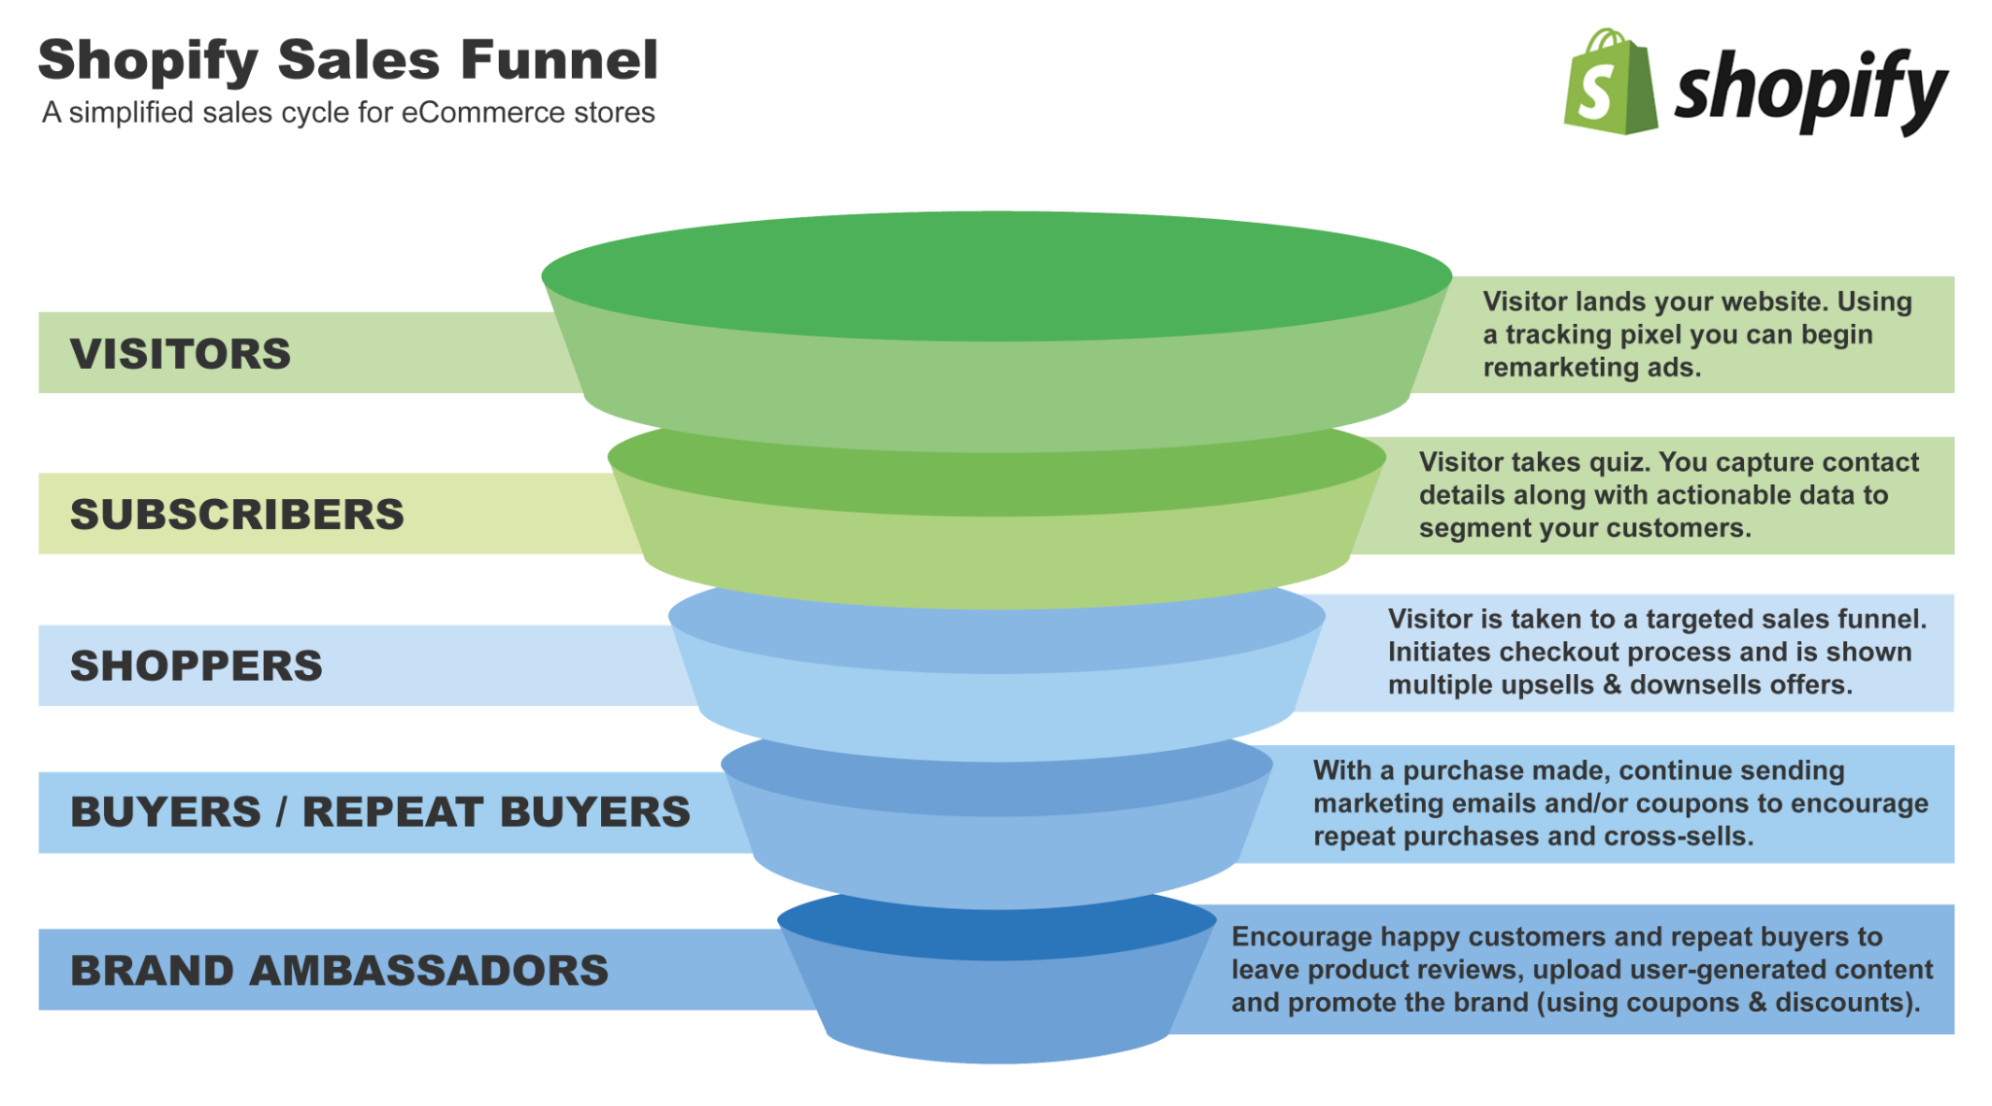
Marketing: sales funnels
Notes:
Image: https://revenuehunt.com/build-sales-funnel-shopify-store/
Image: https://www.autogrow.co/the-evil-isis-sales-funnel-deconstructed/

Slide 10
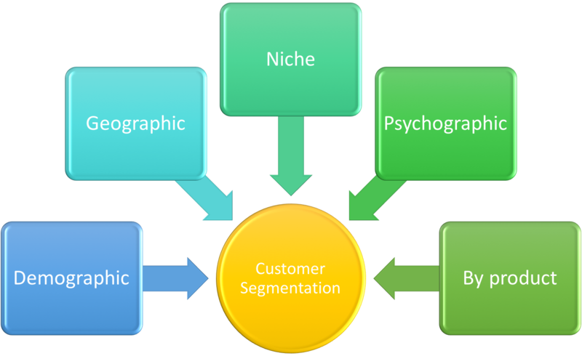
Marketing: Customer segmentation and targetting
Notes:
“Influence to me is being able to control what someone sees about you - which then leads to you being able to control what they think about you. So PR is organized truth” - Ulysses Osuna, Influencer Press
Links
https://www.forbes.com/sites/cognitiveworld/2019/10/04/the-art-of-online-influence/?sh=457a490847ef
https://www.ytcstudios.com/blog/2020/10/5/the-influence-of-fake-news-on-marketing
https://www.dictionary.com/browse/the-medium-is-the-message
Image: https://commons.wikimedia.org/wiki/File:Customer_Segmentation.png

Slide 11
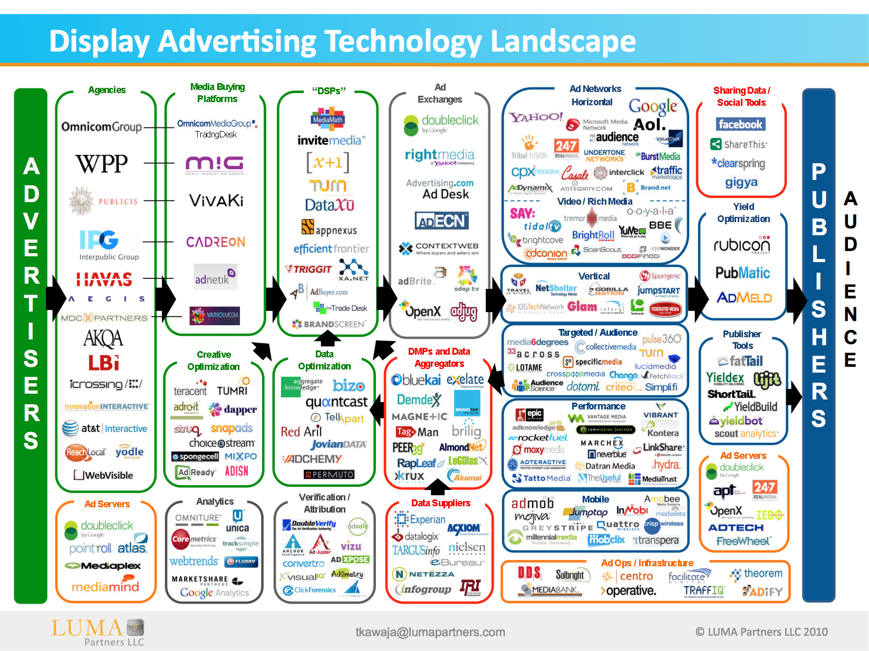
AdTech: microtargeting
Notes:
Image: https://www.adexchanger.com/venture-capital/ecosystem-map-luma-partners-kawaja/

Slide 12
Monitoring and Evaluation: Current Practice

Slide 13
Influencers and websites: Social network models
Change in followers over time
Post reach - who is mentioning an article
Social share of voice: mentions vs other influencer mentions
Direct (@word) vs indirect (word)
Applause rate: likes and follows
Notes:
https://blog.hootsuite.com/social-media-metrics/

Slide 14
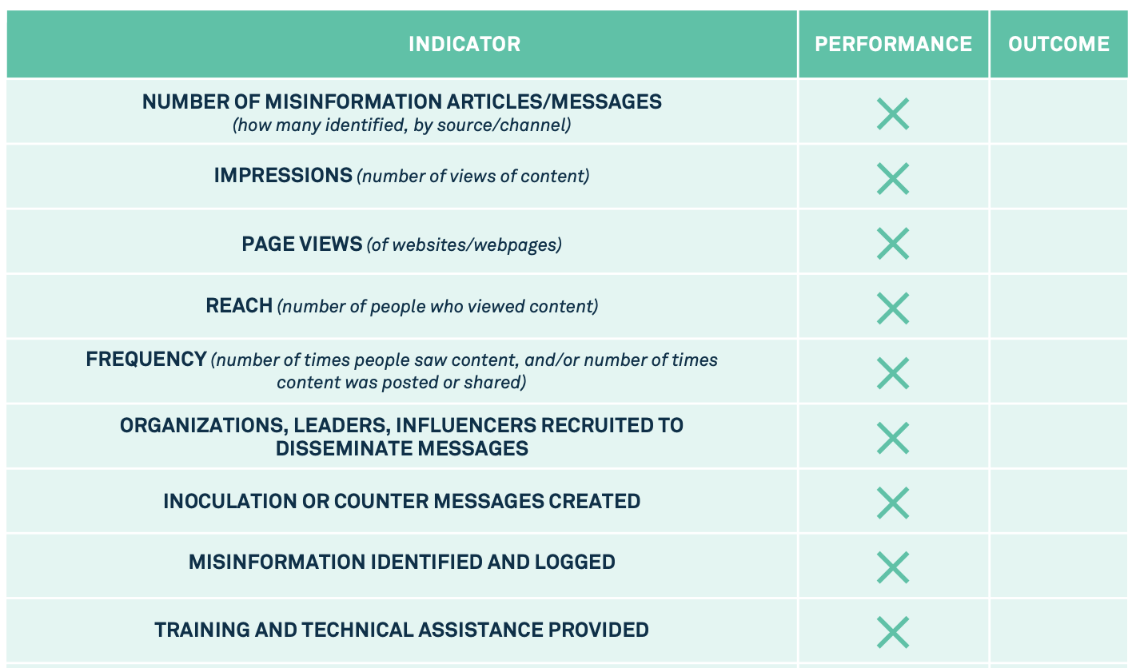
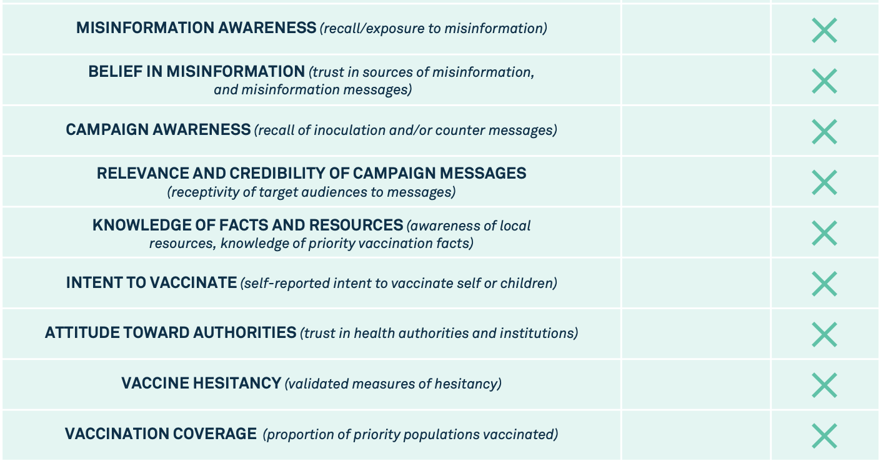
UNICEF: Infodemic Measures
Notes:
https://vaccinemisinformation.guide/

Slide 15
UK Government: RESIST
Objective | Metrics | Effectiveness
Reach the audience vulnerable to a specific piece of disinformation. | Demographic information on the types of people engaging with your content. | Output
Present them with engaging information that captures their attention. | The amount of time people spend viewing information (dwell time), the extent to which they engage with that information (likes, comments, shares). | Output
Direct them to a more in-depth source of legitimate information. | The click-through rate (the number of people who click on a link to more in-depth information), the amount of time people spend viewing that information (dwell time). | Output
Increase the proportion of reporting or online activity that references your communications and messages. | The extent to which your communications are accessible and available in public discourse – for example, of the articles covering an issue or topic, how many reference your message/communications? | Output
Build audience resilience to a specific piece of disinformation and enhance their ability to think critically. | The number of people engaging with a specific piece of disinformation (is it decreasing or increasing?) | Outcome
Change audience views, attitudes and perceptions about a particular issue or topic. | Survey and polling data on the views, attitudes and perceptions of your target audience. | Outcome
Change the way in which the audience behaves. | The number of people amongst your target audience who are changing their behaviour (examples include quitting smoking, getting vaccinated, applying to become a teacher). | Outcome

Slide 16
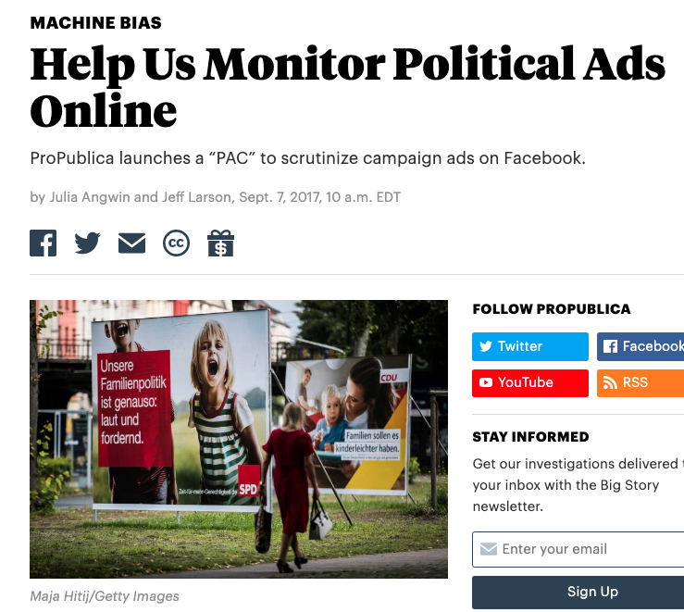
Politics: ad (non) transparency
Notes:
Image: https://www.pewresearch.org/fact-tank/2015/05/19/more-americans-are-using-social-media-to-connect-with-politicians/
https://www.facebook.com/ads/library

Slide 17
Monitoring and Evaluation: How Tos

Slide 18
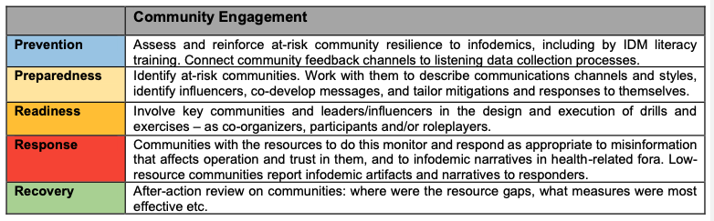
Measuring at different phases

Slide 19
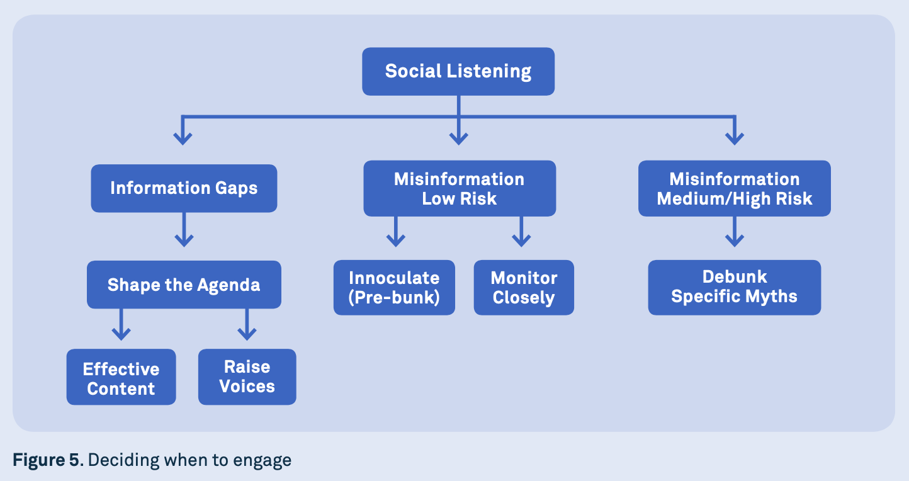
Metrics for deciding when/how to act
image: UNICEF vaccine misinformation field guide

Slide 20
How do you know if this is working?
Assess overall effectiveness
Creators
social share of voice
brand awareness
community fractures
Responders
social share of voice
how well are we reducing cognitive security risk?
community repairs
Assess incident response
Creators
message reach, amplification rate
applause rate, engagement rate etc
Knowledge-based: what is being discussed
Social network-based: who is discussing
Responders
Knowledge based: how accessible (and shared) is trusted information
Network based: did the disinformation sharing slow down?
Notes:
Links:
Knowledge vs Social from Carley’s BEND framework
https://blog.hootsuite.com/social-media-metrics/
Applause rate: number of approvals (likes, favorites) on material relative to views

Slide 21
Performance metrics, Effectiveness metrics
Measures of performance (MoP):
“are we doing things right”
evidence of impacts
Impressions, page views, reach, frequency
Measures of effectiveness (MoE):
“are we doing the right things”
verifiable changes
shifts in knowledge, attitudes, behaviour
Indicator:
Piece of information that tells us more about an MoE or MoP
Notes:
Links:
https://www.benning.army.mil/armor/earmor/content/issues/2014/oct_dec/Westphal.html

Slide 22
Measures of performance
Content focussed:
Number of misinformation articles/ messages (how many, by source / channel)
Number of counter messages created
View focussed:
Impressions: number of views of content
Page views: of websites/ webpages
Volume of misinformation identified and logged
People focussed:
Reach: number of people who saw content
Frequency: number of times people saw content and/or number of times content was posted or shared
Number of organizations/ leaders/ influencers recruited to disseminate messages
Number of people trained/ given technical assistance

Slide 23
Measures of effectiveness
Content
Relevance and credibility of messages (target audience receptivity)
Awareness
Misinformation awareness (recall, exposure)
Counter awareness (inoculation, counter messages)
Knowledge
Belief in misinformation (trust in sources, and messages)
Knowledge of facts and resources (e.g. local resources, priority facts)
Action/ Attitude
Intent to act (vote, vaccinate etc)
Attitude to authorities (trust in influencers, institutions etc)
Hesitancy (hesitancy to vote, vaccinate etc)
Action coverage (votes, inoculations etc)

Slide 24
Communication Effectiveness
“in principle, counter disinformation campaigns should aim to achieve the five objectives set out below:
reach the audience vulnerable to a specific piece of mis- or disinformation (output);
present that information in a manner which engages the audience and captures their attention (output);
direct the the audience to an alternative source of information that is both legitimate and credible (output);
increase the proportion of reporting or online activity that references your communications or information from your communications (output);
build their resilience whilst enhancing their ability to think critically about the information they encounter (outcome);
change their attitudes, perceptions and behaviours towards a particular issue or topic (outcome).” - RESIST
Notes:
Links:
Section 6.2 of the RESIST framework doc https://gcs.civilservice.gov.uk/publications/resist-2-counter-disinformation-toolkit/#Tracking-Effectiveness

Slide 25
Other response types: Risk-based metrics
Changes in loss frequency
Changes in potential losses

Slide 26
Metric gathering methods
Data analysis
Tiplines
Surveys
Chatbots

